Slide 1
Welectricity
by Ninja Hertz

Slide 2
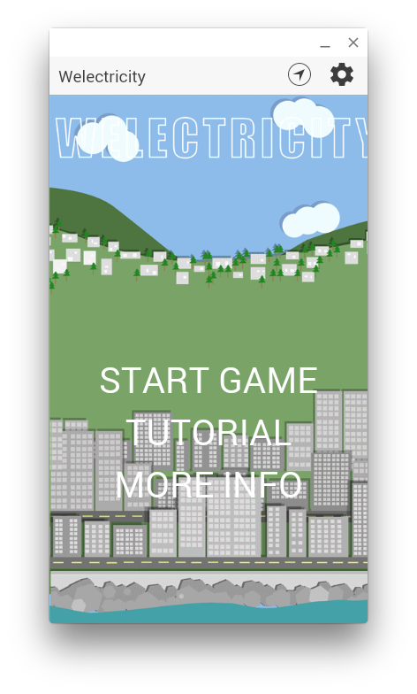
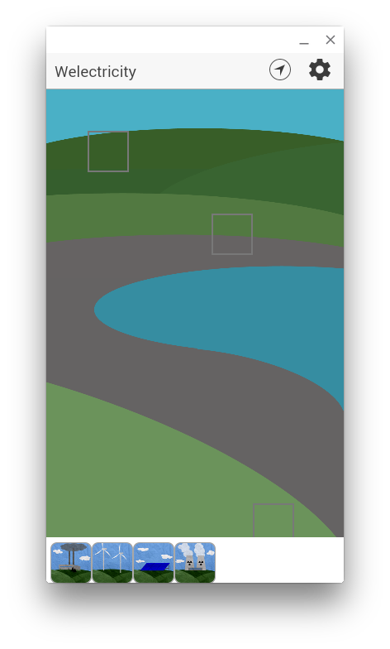
Current Game Screen

Slide 3
Application Architecture
Target user: 5 ~ 12 years-old children
Client
User game interaction
User register/login
Save/load game data to/from server
Server
User login registration and authentication
Response data
Save/load data
Authentication
OAuth

Slide 5

Front-end
Powered by AngularJS framework, combine with HTML, CSS and JavaScript to implement our App.
Dynamic web views
Data binding
Controllers
JavaScript
Extend HTML
Server communication
Testable

Slide 6
Back-end
User information
Username/password
E-mail address
Heroku
Game data
Power plant data
User data
User ID
User name
Host

Slide 7
Database Design
Using Postgres to build our database.
Functions:
Store user register data
Save/Load user game data
Response data to user
Limitations:
Max 10,000 rows
Max 20 concurrent connections

Slide 8
Security Design
OAuth
Unique ID to each registered user.
Username & Password in database
Access via https (not http)
Problems:
Encryption problem
Cookie problem
Our app is FREE & NO ADS, so no such problem with credit card fraud issues.

Slide 9
Reliability Design
Reduce the client app size
Try put “everything” on server -> Database keep update
Problems:
Compatibility on different Android devices (screen size)
iOS sand-box

Slide 10
Scalability Design
Heroku allows to scale up by using dyno.
Problems:
Dyno limitation
User control

Slide 11
Testing
Give it to primary school students to play with it, and then get feedbacks.
Main device is test on Android.

Slide 12
Implementation
Our app is still under developing.
Next things we need to do:
Game play function
Google map display
Parallax dynamic power plant view
Data security
...

Slide 13
Demonstration Video Design

Slide 14
Responsibility (Engineers)
John:
Game engine (gameplay, stats, time…)
Server: save/load/user registration
Drag & Drop functions
Google maps game play
Server architecture
App architecture and git
Tianfu (Tony):
Server/Backend design
Power plant info & loading
Pages architecture: city view, extra information & credits

Slide 15
Responsibility (Designers)
Josh:
Title page design
Splash screen
Animations
Pop-up boxes
Typography
Research & Calculation
Nicola:
City view graphics
Parallax
Sound
Research & Calculation
Navigation
Colour scheme
Art director
Nicolas:
Gameplay images
Power plant icons
Log-in screen

Slide 16
Thank you!
Any questions?

